Slide 1
SWBST: A Summarizing Strategy Teaching Pack
Tools for Close Reading
By Julie Faulkner
For Any Text, Subject, and Grade
Whole Group, Small Group, Individual
Julie Faulkner, TPT

Slide 2
Objective
Summarize the main idea with key details
Julie Faulkner, TPT

Slide 3
Common Core Anchor Standards
CCSS.ELA-Literacy.CCRA.R.2 Determine central ideas or themes of a text and analyze their development; summarize the key supporting details and ideas.
CCSS.ELA-Literacy.CCRA.R.8 Delineate and evaluate the argument and specific claims in a text, including the validity of the reasoning as well as the relevance and sufficiency of the evidence.
CCSS.ELA-Literacy.CCRA.R.10 Read and comprehend complex literary and informational texts independently and proficiently.
CCSS.ELA-Literacy.CCRA.W.2 Write informative/explanatory texts to examine and convey complex ideas and information clearly and accurately through the effective selection, organization, and analysis of content.
Julie Faulkner, TPT
Notes:
TPT Disclaimers:
The Common Core Standards were written and developed by The National Governors Association Center for Best Practices and Council of Chief State School Officers. © Copyright 2010. National Governors Association Center for Best Practices and Council of Chief State School Officers. All rights reserved.
Any claims of correlation or alignment to the CCSS Standards are solely those of Julie Faulkner and have not been evaluated or endorsed by The National Governors Association.

Slide 4
What is a Summary?
a brief statement or account of the main points (key points) of a text
Julie Faulkner, TPT

Slide 5
When should you summarize?
Anytime you read/view a text, you should be thinking of the main idea and key details.
Doing so activates your brain and allows you to begin the process of breaking down the text.
If you aren’t sure the author’s main point or key plot, your full understanding of the text will be skewed.
Julie Faulkner, TPT

Slide 6
Defining the Strategy: SWBST
Somebody – main character, speaker, or author
Wanted - motivation: the gist of the issue; what somebody is trying to accomplish, achieve, or acquire
But - the problem: what is standing in the way of success, the conflict or opposition
So - how the problem is solved
Then - resolution: the ending or outcome, what eventually happened
Julie Faulkner, TPT

Slide 7
SWBST: At a Glance
Somebody | Wanted | But | So | Then
main character, speaker, or author | motivation: the gist of the issue; what somebody is trying to accomplish, achieve, or acquire | the problem: what is standing in the way of success, the conflict or opposition | how the problem is solved | resolution: the ending or outcome, what eventually happened
Julie Faulkner, TPT

Slide 8
SWBST: Example
Somebody | Wanted | But | So | Then
main character, speaker, or author | motivation: the gist of the issue; what somebody is trying to accomplish, achieve, or acquire | the problem: what is standing in the way of success, the conflict or opposition | how the problem is solved | resolution: the ending or outcome, what eventually happened
Cinderella | Wanted to go to the ball. | However, her stepmother wouldn’t let her go. | So, her fairy godmother helped her. | In the end, she married the prince and lived happily ever after.
Julie Faulkner, TPT
Notes:
This is a slide you would share with your students as an example slide of the strategy works with a familiar text.

Slide 9
SWBST: Example
Somebody | Wanted | But | So | Then
main character, speaker, or author | motivation: the gist of the issue; what somebody is trying to accomplish, achieve, or acquire | the problem: what is standing in the way of success, the conflict or opposition | how the problem is solved | resolution: the ending or outcome, what eventually happened
The prince | Wished he could find who the glass slipper would fit, | But no one in the kingdom was a match. | So, the prince kept looking. | Despite the wicked stepsisters, he found Cinderella.
Julie Faulkner, TPT
Notes:
This slide shows how you can use the strategy to explore different points of view.

Slide 10
SWBST: Guided Practice
Somebody | Wanted | But | So | Then
main character, speaker, or author | motivation: the gist of the issue; what somebody is trying to accomplish, achieve, or acquire | the problem: what is standing in the way of success, the conflict or opposition | how the problem is solved | resolution: the ending or outcome, what eventually happened
The wicked stepsisters
Julie Faulkner, TPT
Notes:
Here students will practice completing the strategy for practice. Have several volunteers share.

Slide 11
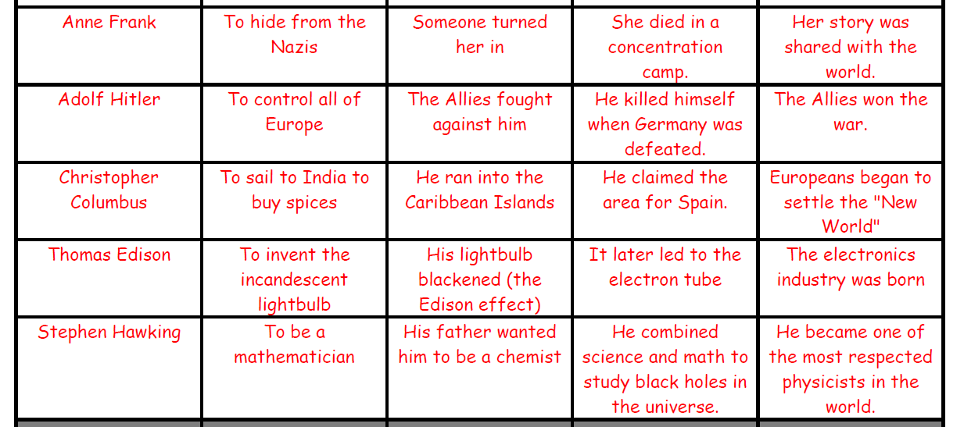
SWBST: Nonfiction Examples
Somebody | Wanted | But | So | Then
Julie Faulkner, TPT
Notes:
Here students will practice completing the strategy for practice. Have several volunteers share.

Slide 12
SWBST: Guided Practice
Somebody | Wanted | But | So | Then
main character, speaker, or author | motivation: the gist of the issue; what somebody is trying to accomplish, achieve, or acquire | the problem: what is standing in the way of success, the conflict or opposition | how the problem is solved | resolution: the ending or outcome, what eventually happened
Julie Faulkner, TPT
Notes:
You can give them the "somebody" to get them going, or choose another portion. Depending on your students’ ages or levels, I often let them choose their “somebody.” Sometimes I say pick a celebrity to write about, or write about a main character from a recent movie. They can even do a few rounds of practice that way, and often I allow them to work with a partner during this guided practice. Sometimes, it even turns into a little bit of a battle round to see who can be more clever than another. I like to have them practice on something “non text-based” or very familiar first as through this presentation, my purpose is to just teach the skill and to have them become familiar with the strategy.

Slide 13
SWBST: Sentence View
One Sentence Summary Template:
________ wanted _______,but___________. So,_____________. Then, _____________.
Julie Faulkner, TPT

Slide 14
SWBST: Ball Toss Review
What is a summary?
When should you summarize?
In the SWBST strategy, what does the S represent? In the SWBST strategy, what does the W represent?
In the SWBST strategy, what does the B represent?
In the SWBST strategy, what does the S represent? In the SWBST strategy, what does the T represent?
Julie Faulkner, TPT
Notes:
To play this closing activity, have a small ball handy. Pull each question up on the screen one at a time. Toss the ball out to one students. He/she answers the question (I do not let them pass or look at notes. They have to look at notes before play begins.) Then he/she passes to another person, and so on.

Slide 15
Thank you!
Art Credits:
Key Art by Collective Creations
Sports Art by Tracee Orman
Thank you for shopping my store! If this resource worked for you, please hop back on over to TPT and leave some positive feedback!
Follow me for updates.
Julie Faulkner, TPT

