Slide 1
A Christmas Carol
by Charles Dickens

Slide 2
Biographical Information: Charles Dickens
At the age of twelve, Dickens had to quit school and take a job at a warehouse, where he worked over twelve hours a day sealing jars of shoe polish to pay his parents’ debts. He went to bed hungry and lonely in a rooming house.
This experience made Dickens aware of the misery of the poor, especially children.
CHILDHOOD
In 1812, Charles Dickens was born in Portsmouth, England as one of eight children.
His father was a clerk and his mother was a teacher. They were not good at managing money so they were often in debt. They were sent to debtor’s prison.

Slide 3
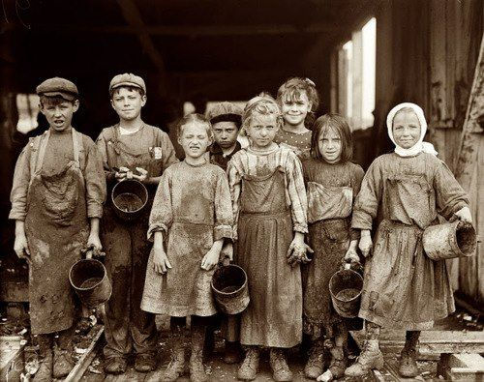
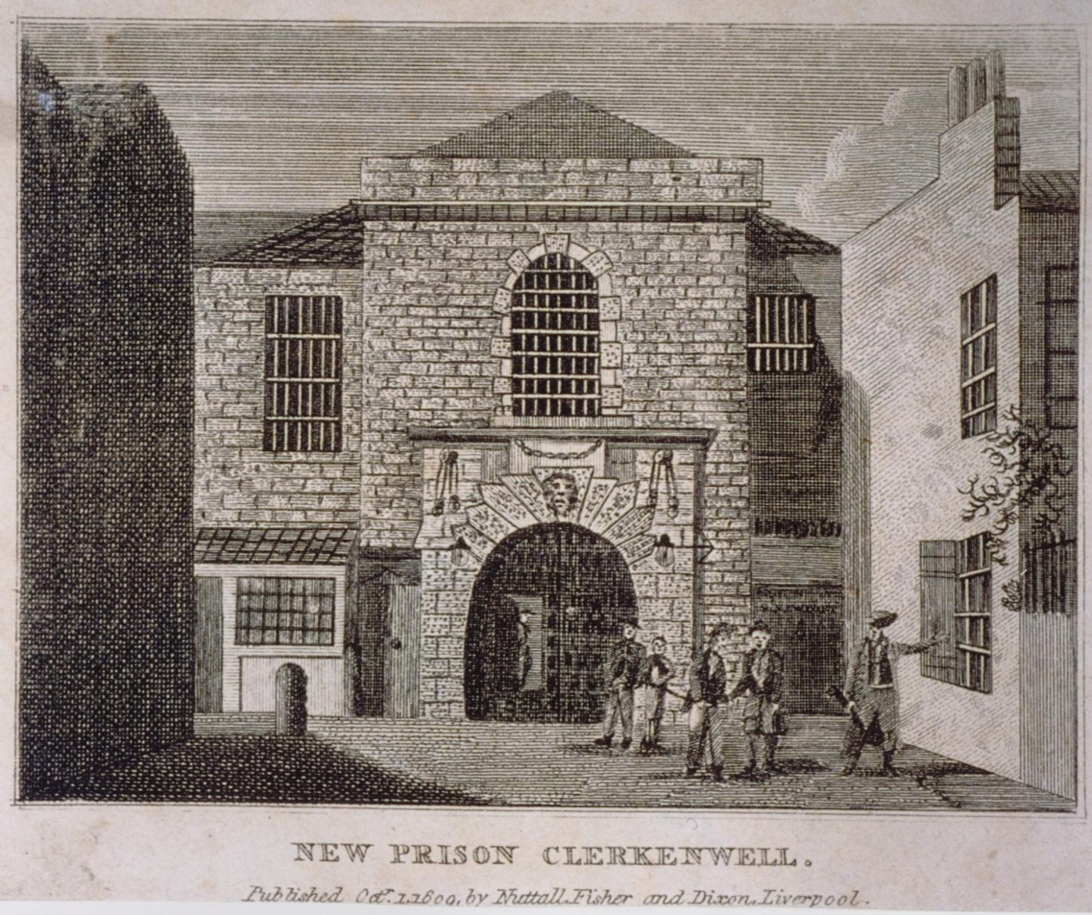
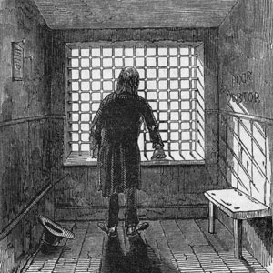
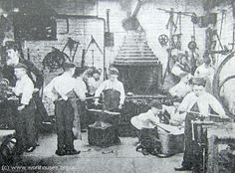
Dickens’s London (1800’s)
Debtor’s Prison in 1800’s London
Workhouses: Children were sent to work long hours under horrible conditions.

Slide 4
Dickens’s Childhood
In later years, Dickens wrote of feeling “…utterly neglected and hopeless…Even now, famous and caressed and happy, I often forget in my dreams and wander desolately back to that time in my life.”

Slide 5
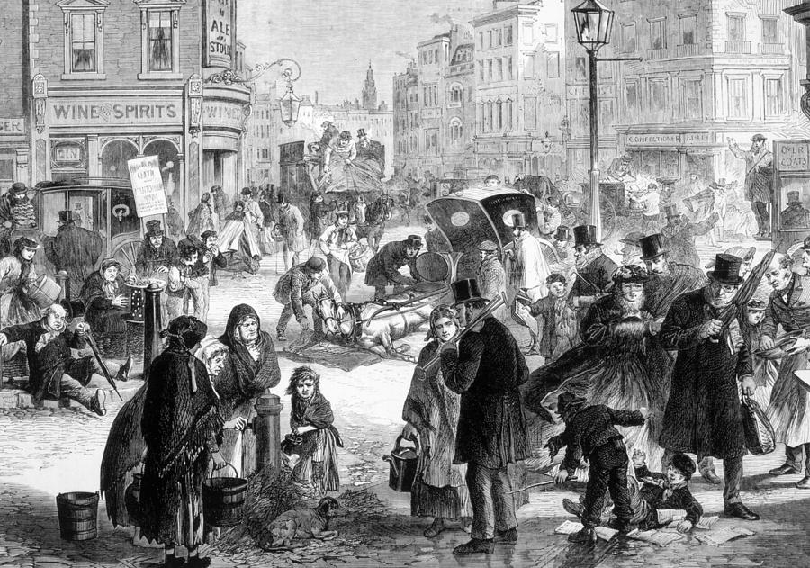
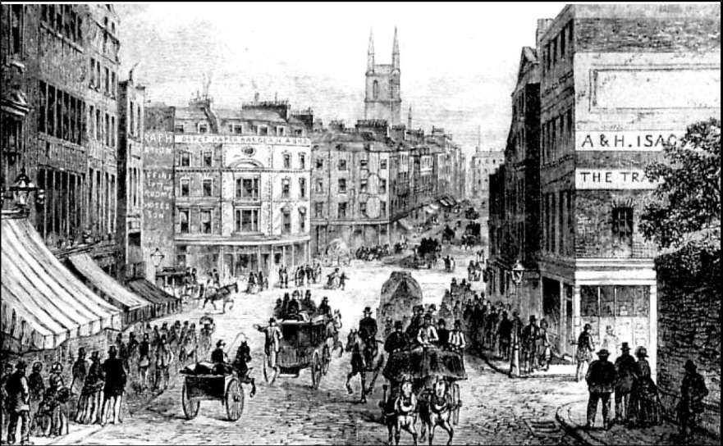
Dickens’s London (1800’s)
“Imagine yourself in the London of the early 19th century. The homes of the upper and middle class exist in close proximity to areas of unbelievable poverty and filth. Rich and poor alike are thrown together in the crowded city streets. Street sweepers attempt to keep the streets clean of manure, the result of thousands of horse-drawn vehicles. The city's thousands of chimney pots are belching coal smoke, resulting in soot which seems to settle everywhere. In many parts of the city raw sewage flows in gutters that empty into the Thames. Street vendors hawking their wares add to the cacophony of street noises. Pick-pockets, prostitutes, drunks, beggars, and vagabonds of every description add to the colorful multitude.”

Slide 6
Biographical Information: Charles Dickens
ADULTHOOD
Dickens later worked as an office boy for an attorney. During this experience, he realized the injustices of the law.
He also worked as a court reporter, actor, and a reporter for two newspapers.
Later he began to write stories. He was a slow writer, but he worked hard.
Besides writing, Dickens devoted time, energy, and money to several charities.
Dickens’ demanding work schedule affected his health. He died of a stroke at the age of 58.
His greatest strength was his ability to create colorful pictures of London's people and life.

Slide 7
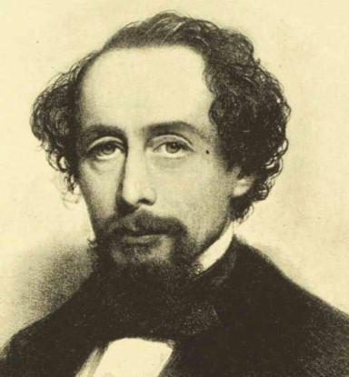
Dickens’s Writing Career
He chose to write novels that criticized the attitudes of the greedy and exposed the abuses of the poor.
By exposing the suffering of the poor in a vivid and sympathetic manner, Dickens convinced readers that conditions had to be corrected.
His novels helped bring about social reform in England.
Dickens published A Christmas Carol himself because his publishers doubted that it would sell.
  Published December 18, 1843
  Overnight bestseller
  Not a novel about religion or Christmas, but ended up revolutionizing the holiday
  Christmas celebration was in decline before the novel
Other popular works by Dickens include:
  Oliver Twist
  David Copperfield
  A Tale of Two Cities
  Great Expectations
  Bleak House

Slide 8
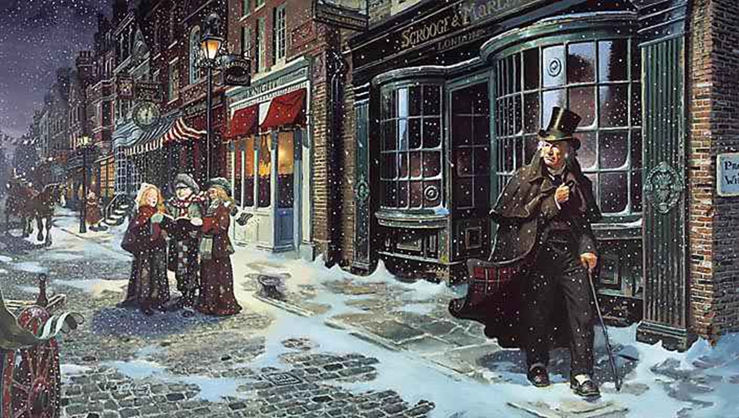
A Christmas Carol

Slide 9
Literary Terms/Rhetorical Devices
Rite of Passage: a life-changing journey to become a hero (separation, transformation, reincorporation, trigger, moment of insight).
Theme: the main idea/message of a work.
Symbol: physical objects, people, or places that represent something deeper beyond themselves.
Foreshadowing: a writer’s use of hints or clues to indicate events and situations that will occur later in a plot. The use of this technique creates suspense while preparing the reader for what is to come.

Slide 10
Literary Terms/Rhetorical Devices
Flashback: a scene that interrupts the present action of the plot to flash backward and show what happened at an earlier time.
  Foil: a character who provides a striking contrast to another character. By using a foil, a writer can call attention to certain traits possessed by a character, usually the protagonist.
Dynamic Character: one who changes during the course of the literature .
Static Character: one who remains relatively unchanged during the course of the literature.

Slide 11
A Christmas Carol Characters
Ebenezer Scrooge - The miserly owner of a London counting-house, a nineteenth century term for an accountant's office. The three spirits of Christmas visit the stodgy bean-counter in hopes of reversing Scrooge's greedy, cold-hearted approach to life.
Bob Cratchit - Scrooge's clerk, a kind, mild, and very poor man with a large family. Though treated harshly by his boss, Cratchit remains a humble and dedicated employee.
Tiny Tim - Bob Cratchit's young son, crippled from birth. Tiny Tim is a highly sentimentalized character who Dickens uses to highlight the tribulations of England's poor and to elicit sympathy from his middle and upper class readership.
Jacob Marley - In the living world, Ebenezer Scrooge's equally greedy partner. Marley died seven years before the narrative opens. He appears to Scrooge as a ghost condemned to wander the world bound in heavy chains. Marley hopes to save his old partner from suffering a similar fate.

Slide 12
A Christmas Carol Characters
The Ghost of Christmas Past - The first spirit to visit Scrooge, a curiously childlike apparition with a glowing head. He takes Scrooge on a tour of Christmases in his past. The spirit uses a cap to dampen the light emanating from his head.
The Ghost of Christmas Present - The second spirit to visit Scrooge, a majestic giant clad in a green robe. His lifespan is restricted to Christmas Day. He escorts Scrooge on a tour of his contemporaries' holiday celebrations.
The Ghost of Christmas Yet to Come - The third and final spirit to visit Scrooge, a silent phantom clad in a hooded black robe. He presents Scrooge with an ominous view of his lonely death.

Slide 13
A Christmas Carol Characters
Fred - Scrooge's nephew, a genial man who loves Christmas. He invites Scrooge to his Christmas party each and every year, only to be refused by his grumpy uncle.
Fan - Scrooge's sister; Fred's mother. In Scrooge's vision of Christmases past, he remembers Fan picking him up from school and walking him home.
Fezziwig - The jovial merchant with whom the young Scrooge apprenticed. Fezziwig was renowned for his wonderful Christmas parties.
Belle - A beautiful woman who Scrooge loved deeply when he was a young man. Belle broke off their engagement after Scrooge became consumed with greed and the lust for wealth. She later married another man.

Slide 14
Preface
“I have endeavored in this Ghostly little book to raise the Ghost of an Idea which shall not put my readers out of humor with themselves, with each other, with the season, or with me. May it haunt their house pleasantly, and no one wish to lay it.
Their Faithful Friend and Servant
C.D.
December 1843”

